Slide 1
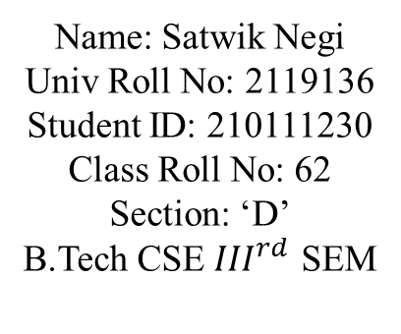
Mini Project Presentation
Supermarket Billing Management System Using C++
Name: Satwik Negi
Univ Roll No: 2119136
Student ID: 210111230
Class Roll No: 62
Section: ‘D’
B.Tech CSE ${III}^{rd}$ SEM

Slide 2
Table Of Contents
About The Project
Language Used C++
About The Source Code
Screenshots Of Code
Output
References

Slide 3

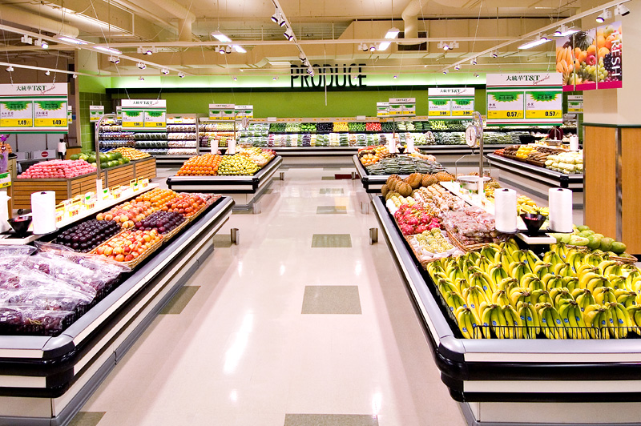
About The Project
My topic is Supermarket Billing Management System using C++. The supermarket billing system is intended to help supermarkets calculate and show invoices, as well as provides faster and more effective customer service. The user interface of this software solution is both efficient and user-friendly, helping staff members with customer service and bill calculation.
They can keep their money in order since billing software is one of the greatest options for all kinds of grocery store enterprises. A good billing program can retain accurate financial records and eliminate human data entry mistakes. By ensuring that the billing system is transparent and that the precise amount has been stated for the purchases, the supermarket billing system helps to preserve a good connection between the customer and the shop management. It enables and guarantees consumer payment.

Slide 4

Language Used:
C++ was initially known as “C with classes, ” and was renamed C++ in 1983. ++ is shorthand for adding one to variety in programming; therefore C++ roughly means that “one higher than C.”
C++ is a general-purpose, middle-level language that was originally developed by Danish computer scientist, Bjarne Stroustrup in 1979 at Bell Laboratories USA. As many of you must know, a mid-level programming language is a combination of low-level & high-level programming languages.
C++ is a powerful general-purpose programming language. It can be used to develop operating systems, browsers, games, and so on. C++ supports different ways of programming like procedural, object-oriented, functional, and so on. This makes C++ powerful as well as flexible.
The main advantages of C++ are that it is a highly efficient language, has excellent performance, and boasts great memory management. C++ also supports object-oriented programming principles, making development more manageable and organized. It can create/destroy objects while programming. Also, It can create blueprints with which objects can be created.

Slide 5

About The Source Code
Header Files:
#include <iostream> It stands for standard input-output stream. #include iostream declares objects that control reading from and writing to the standard streams. In other words, the iostream library is an object- oriented library that provides input and output functionality using streams.
#include <fstream> Fstream is a library that consists of both, ofstream and ifstream which means it can create files, write information to files, and read information from files. This header file is generally used as a data type that represents the file stream.

Slide 6
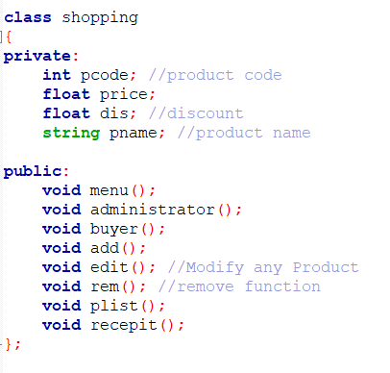
Class: In C++ programming, a Class is a fundamental block of a program that has its own set of methods and variables. You can access these methods and variables by creating an object or the instance of the class. C++ was built entirely with objects in mind, C++ uses classes to make it easy to work with objects. Classes and objects became the building blocks C++ uses for creating streamlined and easy-to- read code. In object-oriented programming, a class is an extensible program-code-template for creating objects, providing initial values for state (member variables) and implementations of behavior (member functions or methods).

Slide 7
Functions:
void menu(): It will display the basic structure for the Supermarket Billing System.
void administrator(): This function will help you to Add, Modify and Remove the products that you want to in your list.
void buyer(): This function will help you to buy the products that are in the list and also will tell you about the at what quantity you want to buy the product.
void add(): In this function the user will add the product into the list and a file will be created for the data of all the products.
void edit(): This function will help you to modify a product that you have already inserted.
void rem(): This function will remove the product that you don’t need.
void plist(): In this function a list will be generated of the products that you have inserted.
void receipt(): Here a list will display of all the items that you have inserted. In this function it will ask you to enter the product code of the product that you want to buy. It will also ask you about how much quantity will you buy. After following this it will generate a receipt of the total billing.

Slide 8
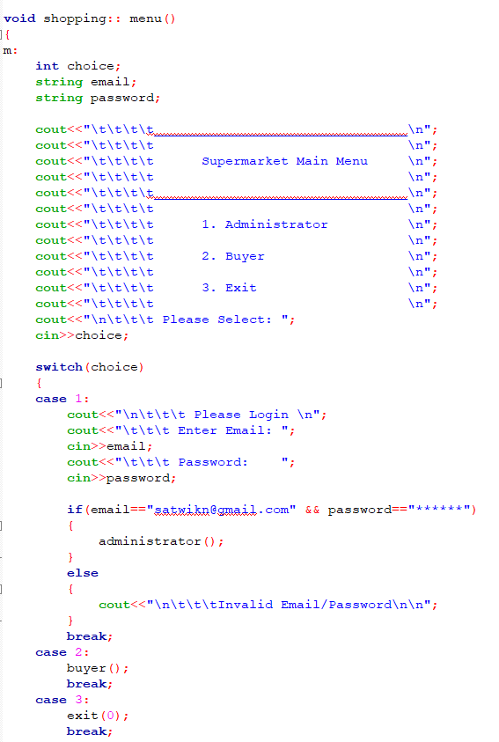
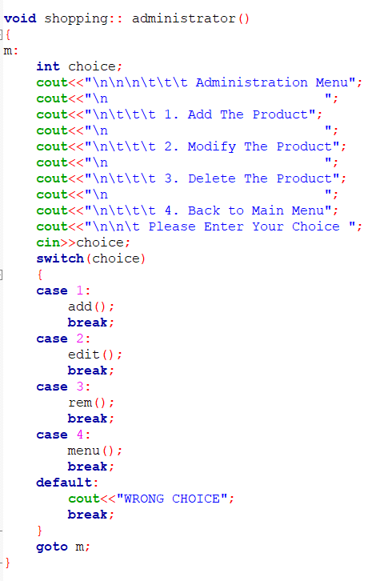
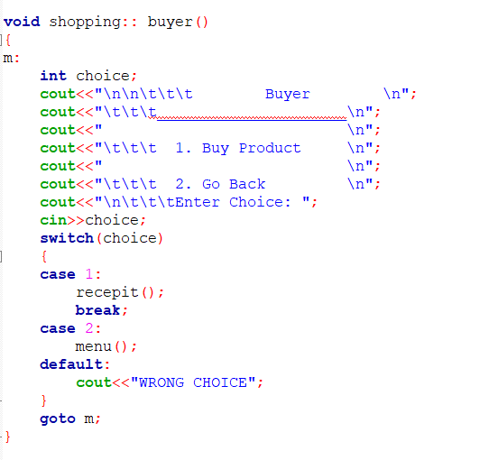
Screenshots Of Code

Slide 9
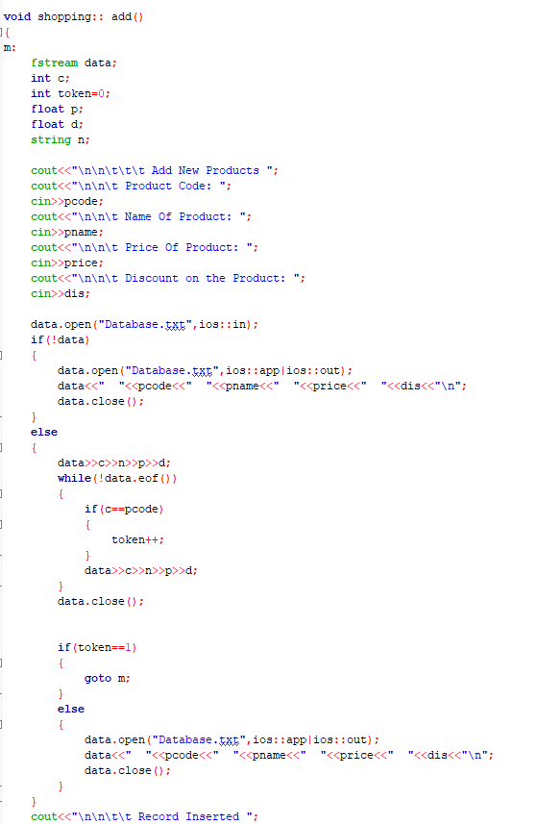
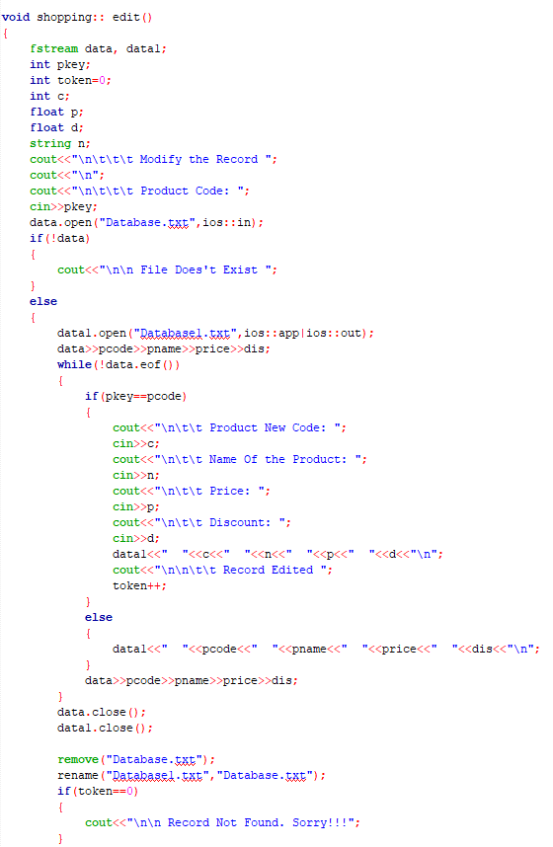

Slide 10
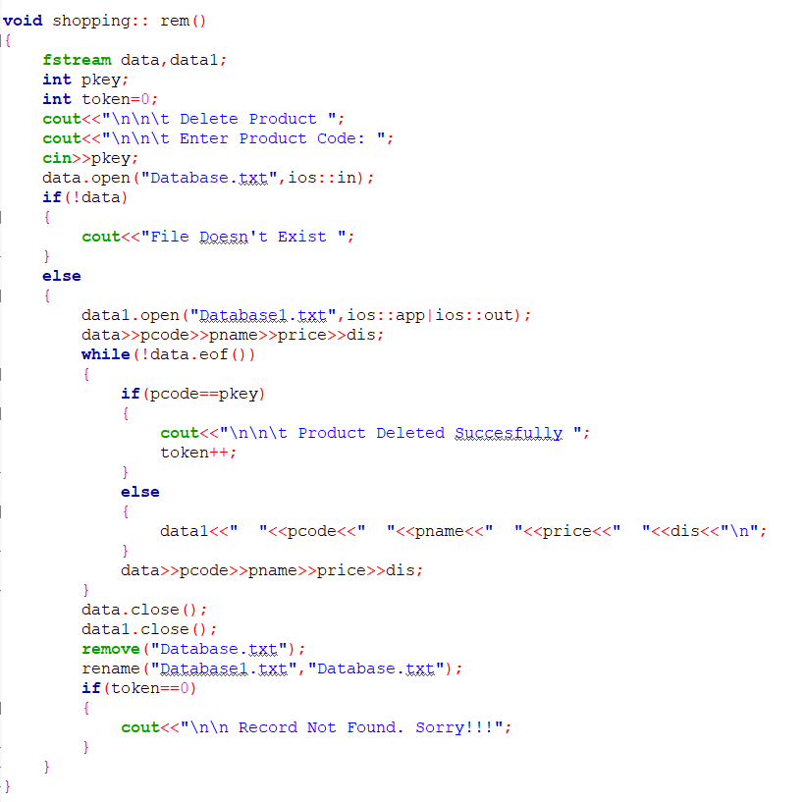
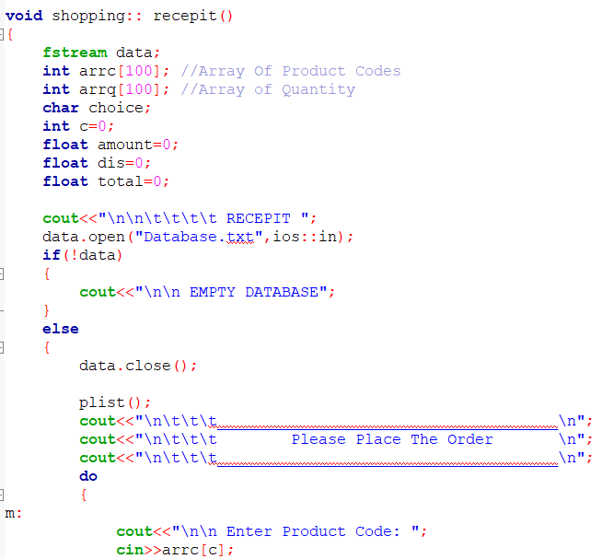
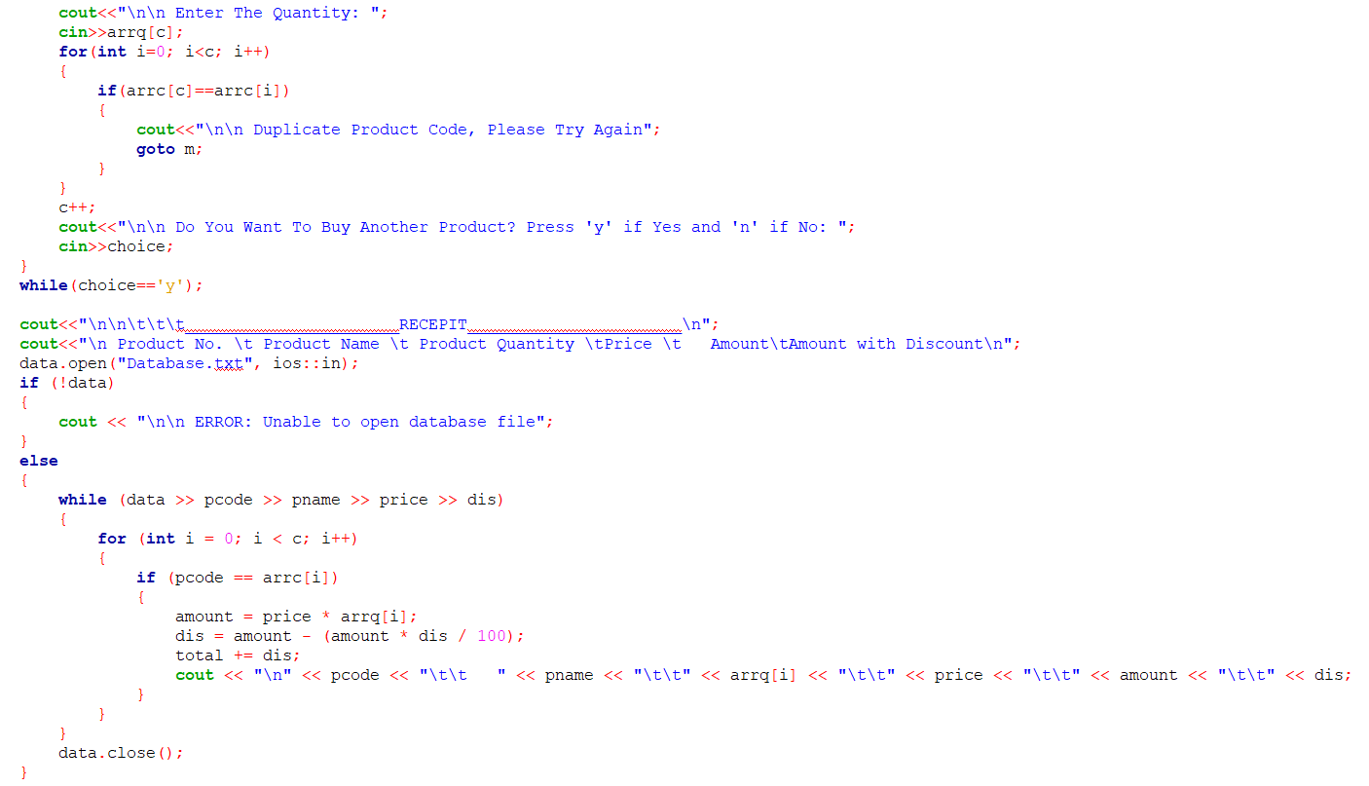
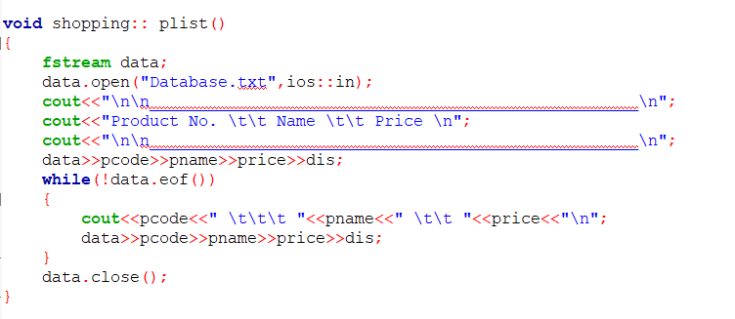

Slide 11
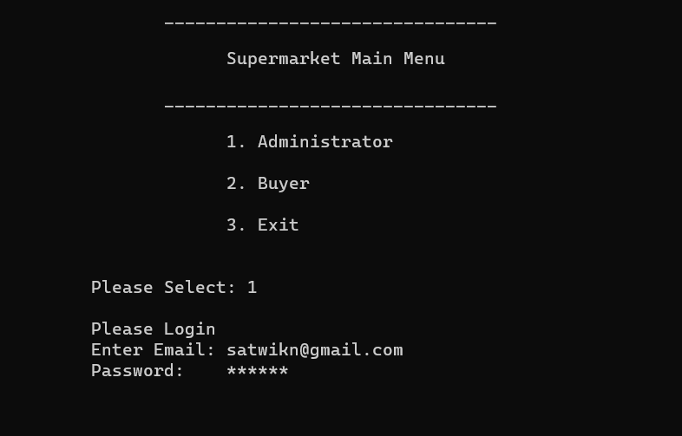
Output

Slide 12
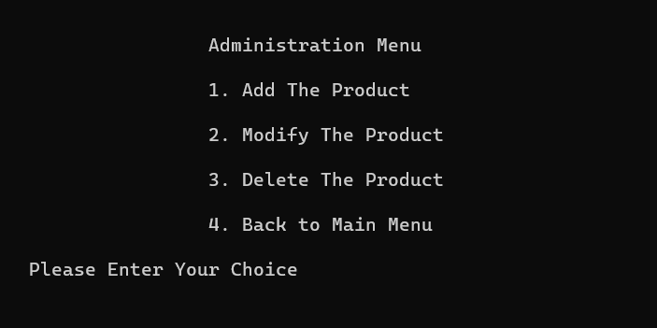
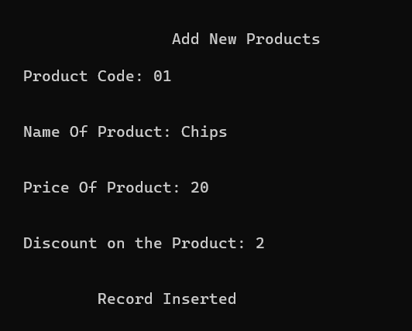
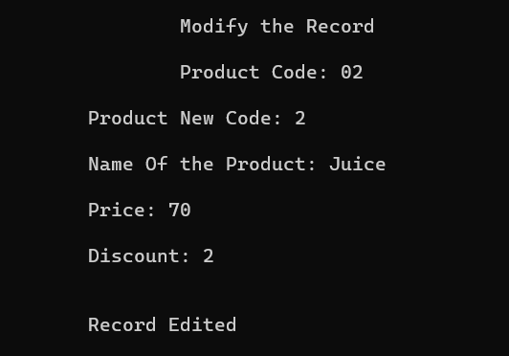
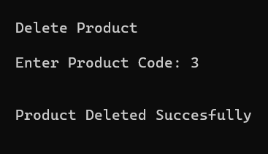
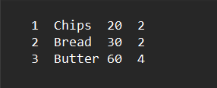
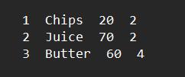
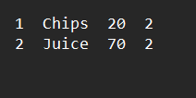

Slide 13
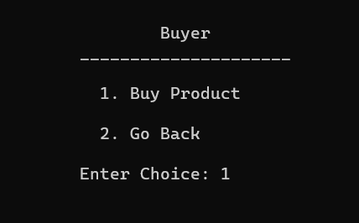
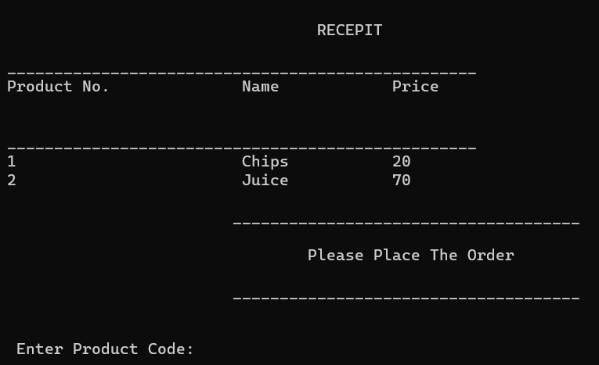
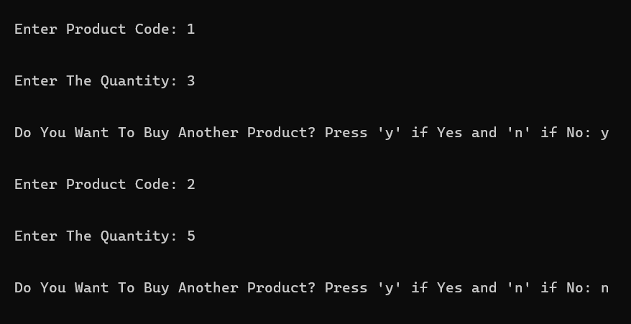

Slide 14
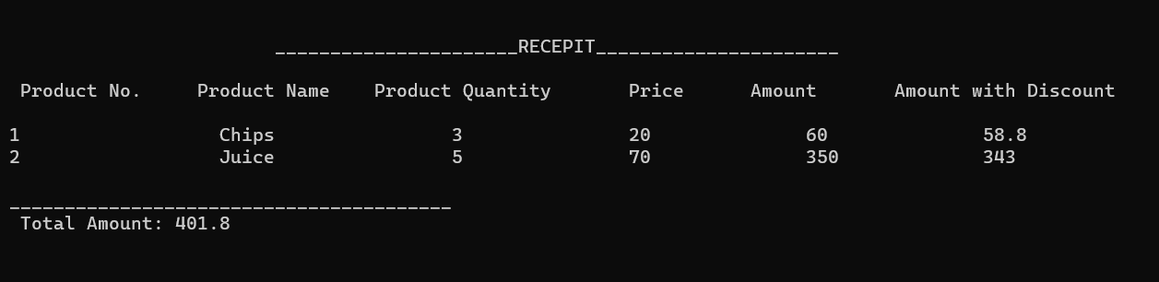

Slide 15




References
>> https://www.geeksforgeeks.org/
>> https://www.programiz.com/
>> https://github.com/
>> https://www.youtube.com/

Slide 16


